Slide 1

Team Members:
Ahmed Hassan
PROJECT:
NexLink Company
Abdulrahman Ibrahim Zaki
Omar Rafat Abdelmagid
Mohamed Essam Ahmed
Supervisor:
QAL1_ISS2_M1e
Gamal Essam El-Nagar

Slide 2
Scenario Overview:
A company has several buildings (Building A, Building B, and Building C) connected to a Headquarters (HQ). Each building has its own internal networks segmented by VLANs, with dynamic IP assignment through DHCP. The company uses BGP as its external routing protocol to communicate with other branches or the internet, while internal communication between the different buildings and HQ uses inter-VLAN routing.
Additionally, SSH is implemented for secure remote management of network devices across the network.
Company
Structure

Slide 3
Network Requirements:
Routing Protocol: BGP for external routing.
Internal Routing: Inter-VLAN routing using a Layer 3 switch.
DHCP: Each VLAN in every building and HQ should have DHCP assigned IP addresses.
SSH: Enable SSH on all routers for secure management.
Connectivity: Each building connects to HQ through routers.
Company
Structure

Slide 4
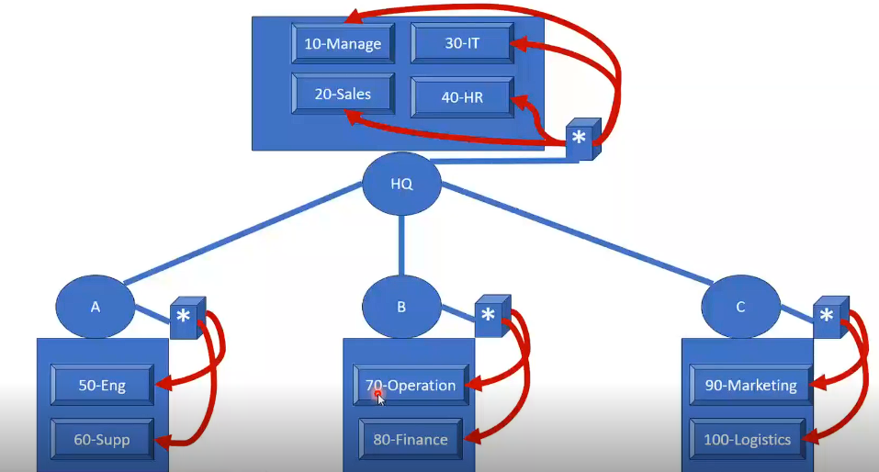
Network Topology:
Headquarters (HQ):
Router: HQ-Router (BGP-enabled)
Layer 3 Switch: HQ-Switch (Inter-VLAN
routing)
VLANS:
VLAN 70 (Management): 70.0.0.0/24
VLAN 80 (Sales): 80.0.0.0/24
VLAN 90 (IT): 90.0.0.0/24
VLAN 100 (HR): 100.0.0.0/24.
Building A:
Router: BuildingA-Router (BGP-enabled)
Layer 3 Switch: BuildingA-Switch (Inter-
VLAN routing)
VLANS:
VLAN 50 (Engineering): 50.0.0.0/24
VLAN 60 (Support): 60.0.0.0/24

Slide 5
3) Building B:
Router: BuildingB-Router (BGP-enabled)
Layer 3 Switch: BuildingB-Switch (Inter-VLAN routing)
VLANS:
VLAN 40 (Operations): 40.0.0.0/24
VLAN 30 (Finance): 30.0.0.0/24
4) Building C:
Router: BuildingC-Router (BGP-enabled)
Layer 3 Switch: BuildingC-Switch (Inter-VLAN routing)
VLANS:
VLAN 20 (Logistics): 20.0.0.0/24
VLAN 10 (Marketing): 10.0.0.0/24
Network Topology

Slide 6
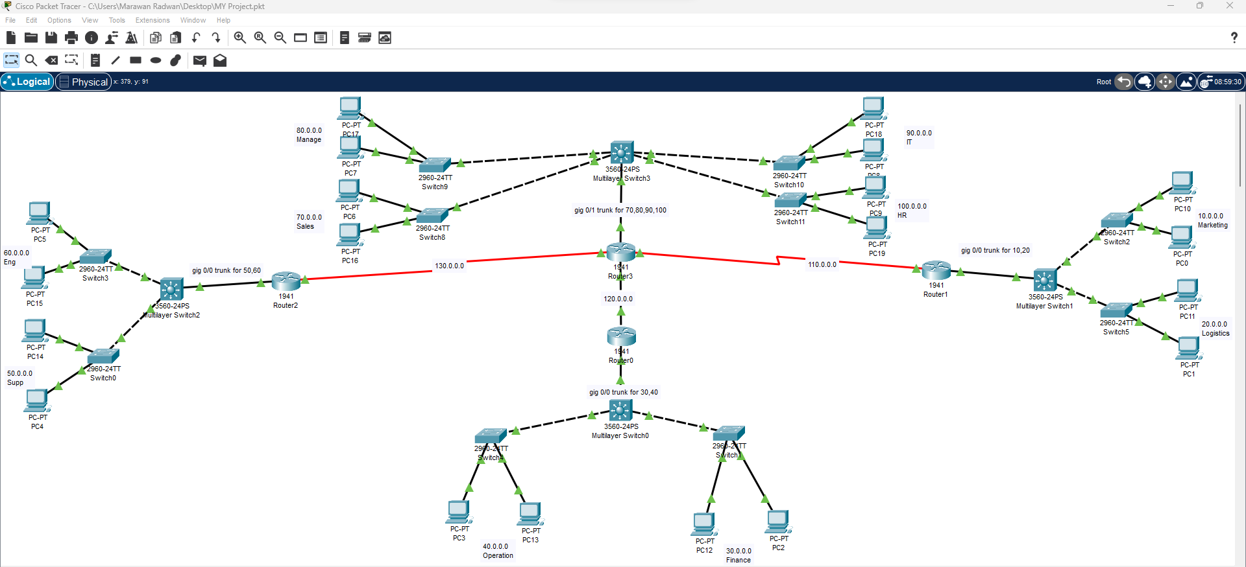

Slide 7
Network Configuration Plan:
BGP Configuration:
Each building and HQ will have BGP configured with a unique Autonomous System Number (ASN). For simplicity:
HQ uses ASN 65000.
Building A uses ASN 65001.
Building B uses ASN 65002.
Building C uses ASN 65003.
External BGP (eBGP) neighbors will be established between the HQ and each building router.
Inter-VLAN Routing:
Layer 3 switches at each location will handle inter-VLAN routing.
VLANs are assigned different subnets, and the Layer 3 switch will route traffic between VLANs at each location.

Slide 8
Network Configuration Plan:
3. DHCP Configuration:
Each building and HQ will have DHCP pools configured for each VLAN.
Routers will act as DHCP relay agents, forwarding DHCP requests to the DHCP servers in each building or HQ.
4. SSH Configuration:
SSH will be enabled on all routers for secure remote management.

Slide 9
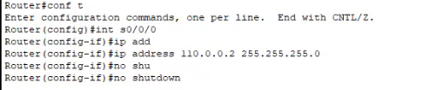
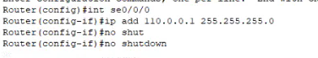
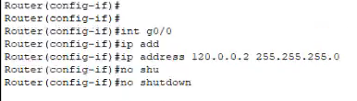
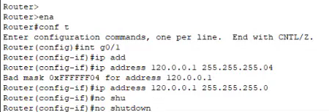
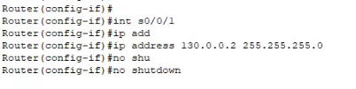
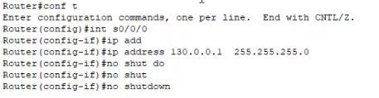
BGP Configuration:

Slide 10
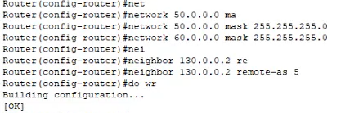
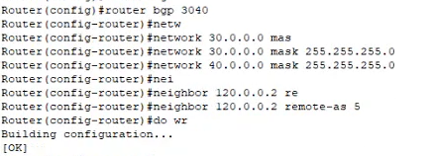
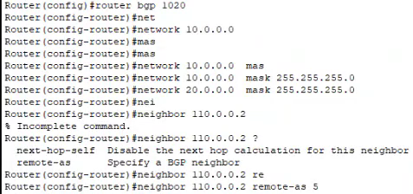
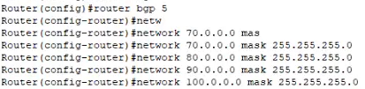
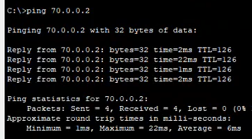
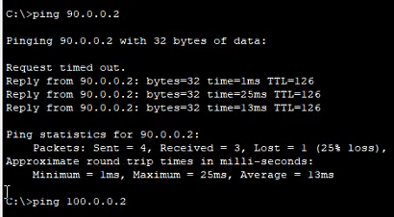
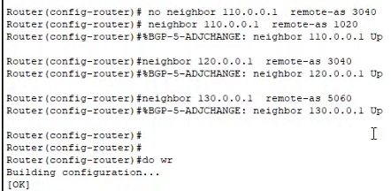
BGP Applied at Building A,B,C and Headquarters (HQ)

Slide 11
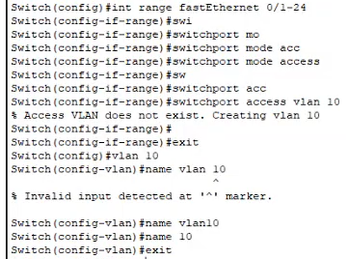
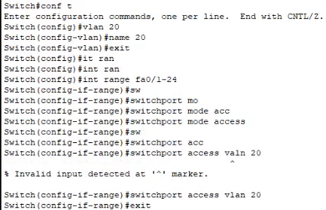
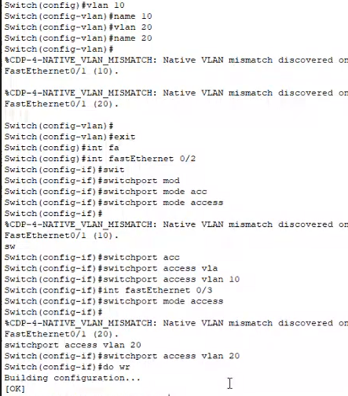
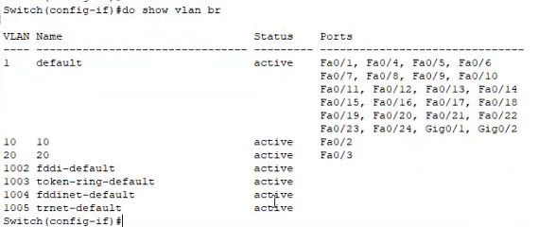
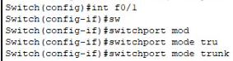
2. Inter-VLAN Routing:
Assign VLAN10&20 at Building C on two switches and multilayer switch
11

Slide 12
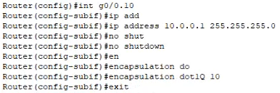
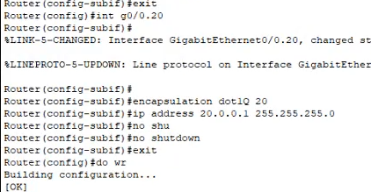
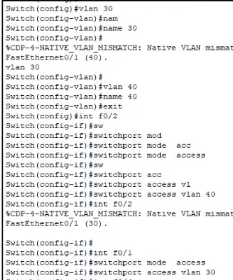
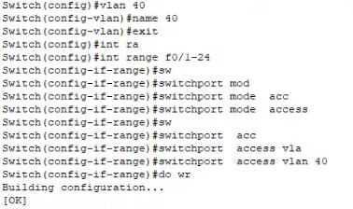
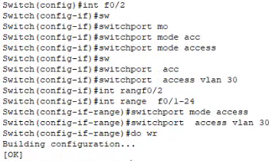
Inter VLAN Routing Done on Building C
-----------------------------------------------------------------------------------------
Assign VLAN30&40 at Building B on two switches and multilayer switch

Slide 13
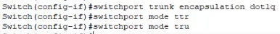
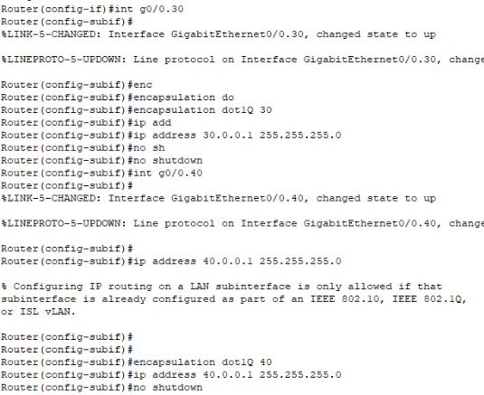
Inter VLAN Routing Done on Building B

Slide 14
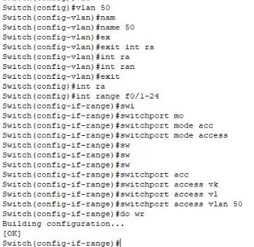
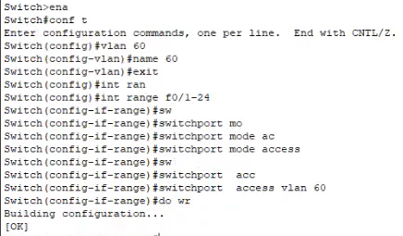
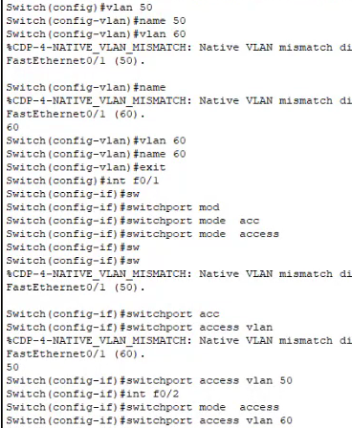
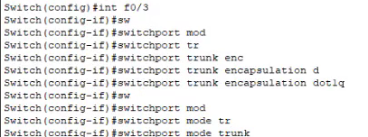
Assign VLAN 50&60 at Building A on two switches and multilayer switch

Slide 15
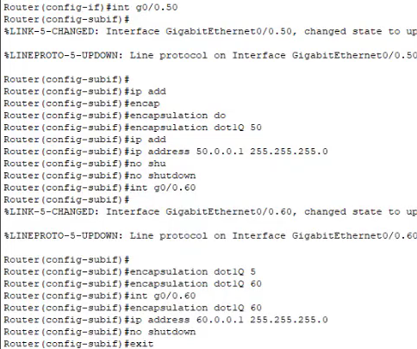
Inter VLAN Routing Done on Building A

Slide 16
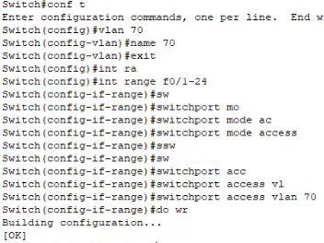
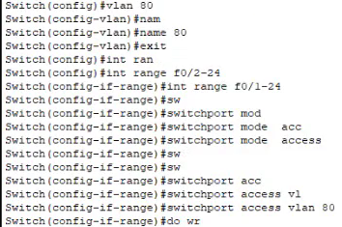
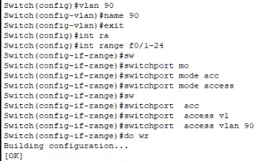
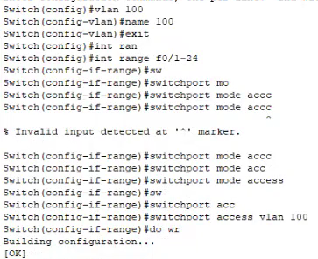
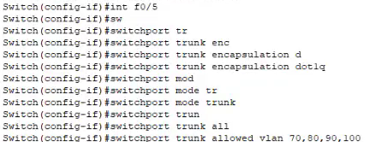
Assign VLAN 70,80,90&100 at Headquarters (HQ) on four switches and multilayer switch

Slide 17
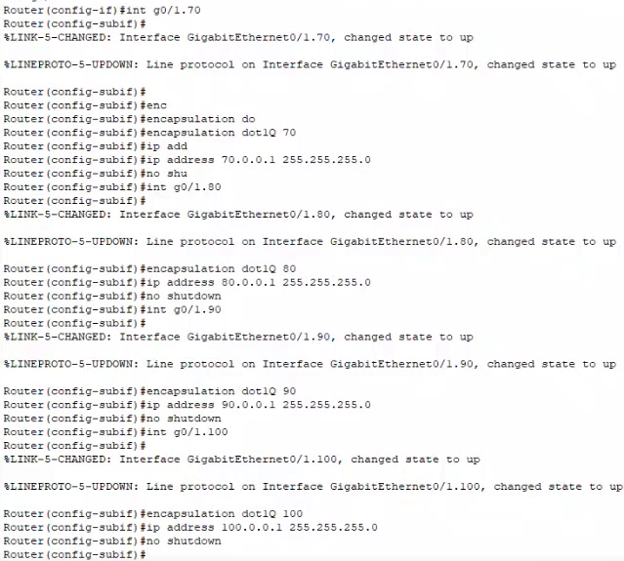
Inter VLAN Routing Done on Headquarters (HQ)

Slide 18
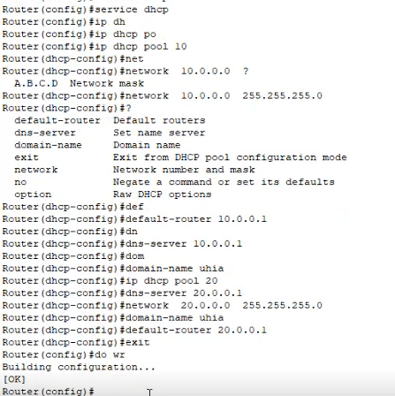
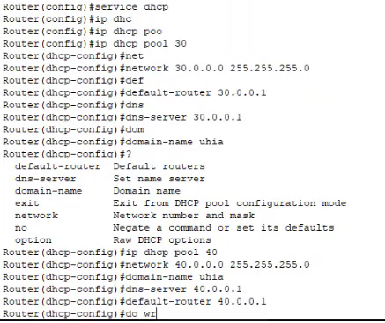
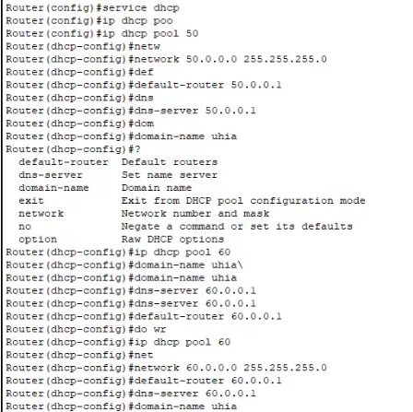
3. DHCP Configuration:
DHCP applied for Building A on VLAN 50&60
DHCP applied for Building B on VLAN 30&40
DHCP applied for Building C on VLAN 10&20

Slide 19
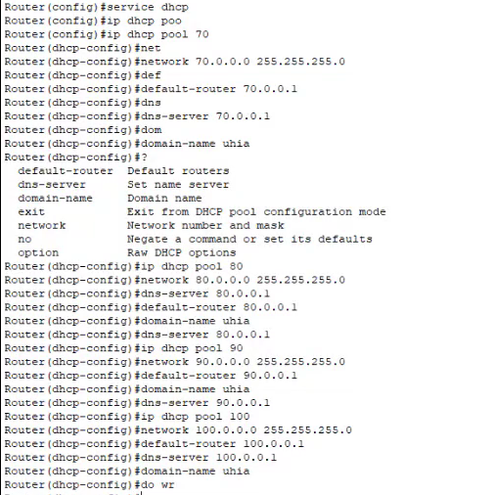
DHCP applied for Headquarters (HQ) on VLAN 70,80,90&100

Slide 20
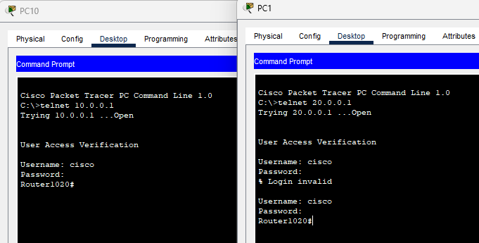
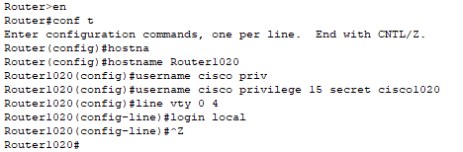
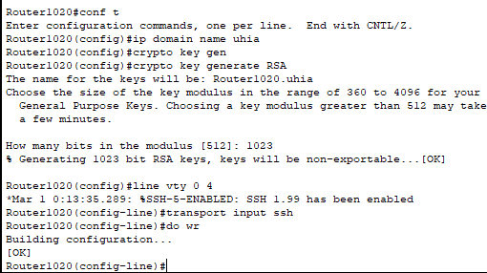
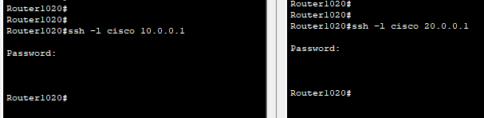
4. SSH Configuration:
Telnet applied (Unsecure)
SSH applied (secure) for building C

Slide 21
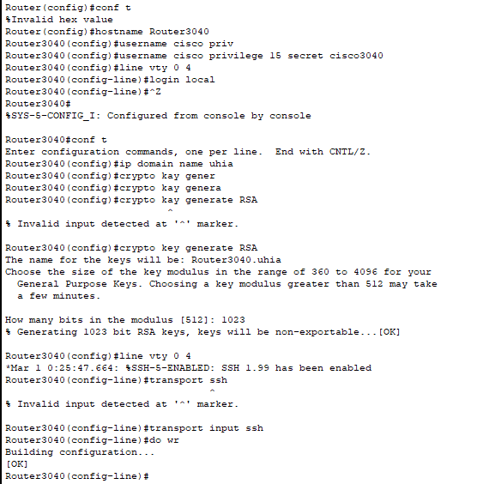
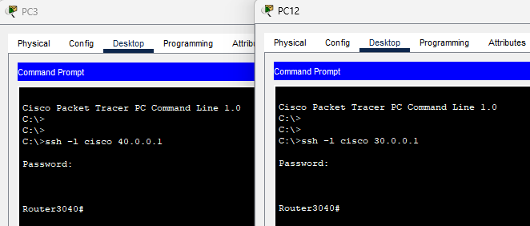
SSH applied (secure) for building B

Slide 22
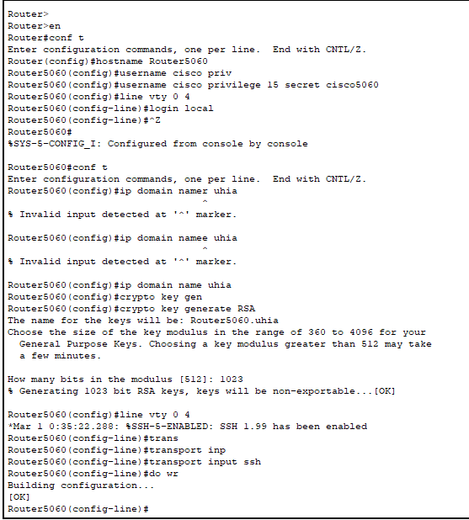
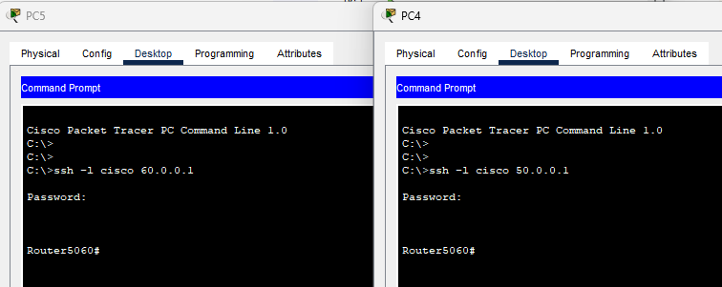
SSH applied (secure) for building A

Slide 23


SSH applied (secure) for Headquarters (HQ)

Slide 24
Thank You

